Slide 1

INTERPOLATION
prepared by Razana Alwee
Notes:
prepared by Razana Alwee

Slide 2
Interpolation
In this topic, we study methods for representing a function based on knowledge of its behavior at certain discrete points.
From this information, we may wish to obtain estimates of function values at other points,
Interpolation produces a function that matches the given data exactly; we seek a function that also provides a good approximation to the (unknown) data values at intermediate points.
The data may come from measured experimental values or computed values from other numerical methods.
prepared by Razana Alwee

Slide 3
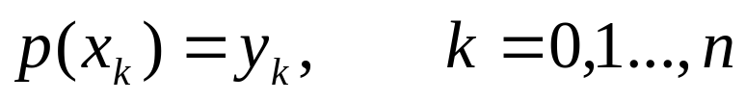

Interpolation
Suppose we have a set of points {x₀, x₁, … , x_{n}} ordered so that x₀<x₁<…<x_{n} and a set of y-values y₀, y₁, …, y_{n} corresponding to the x-values (that is, (x_{i}, y_{i}) is a pair).
The polynomial interpolation problem is to find a polynomial p(x) of degree at most n that interpolates the data (x₀, y₀), (x₁, y₁), …, (x_{n}, y_{n})
prepared by Razana Alwee

Slide 4
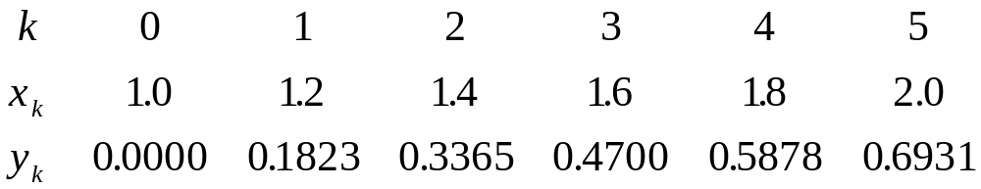
Example
y(1.1) = ??
y(1.5) = ??
prepared by Razana Alwee

Slide 5
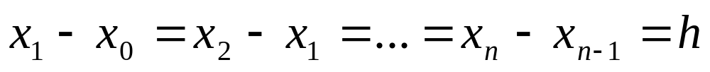
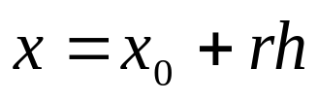
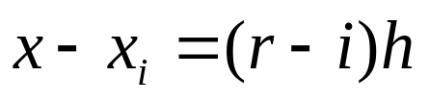
Newton Forward-Difference Formula
x₀, x₁, … , x_{n} are arranged consecutively with equal spacing.
Let,
then the difference x-x_{i} can be written as
prepared by Razana Alwee

Slide 6
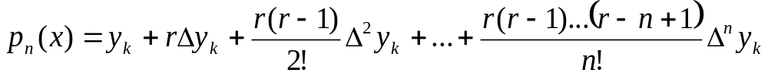
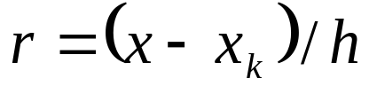
Newton Forward-Difference Formula
Newton Forward-Difference Formula
prepared by Razana Alwee

Slide 7
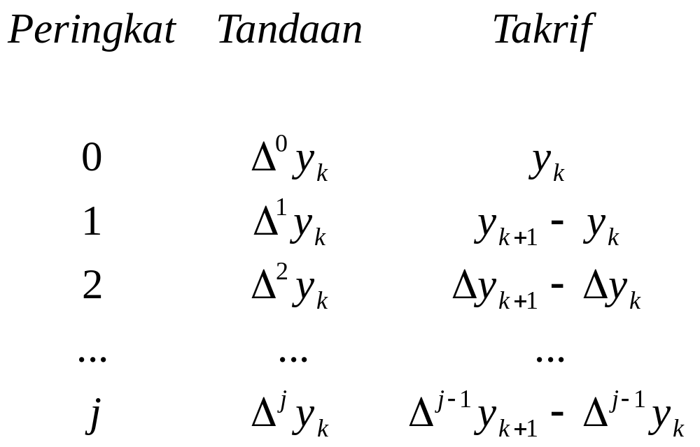
Newton Forward-Difference Formula
Forward-difference Notation
prepared by Razana Alwee

Slide 8
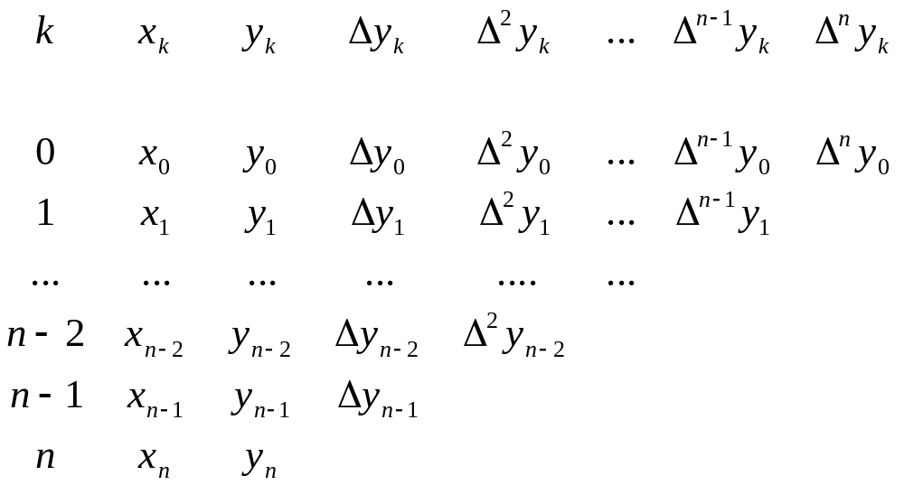
Newton Forward-Difference Formula
Forward-difference Table
prepared by Razana Alwee

Slide 9
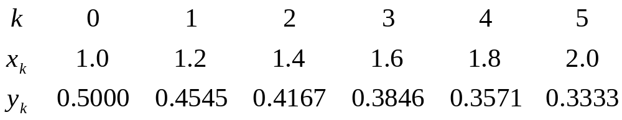
Example
Given the following data:
Use the Newton forward-difference formula to approximate y(1.1).
prepared by Razana Alwee

Slide 10
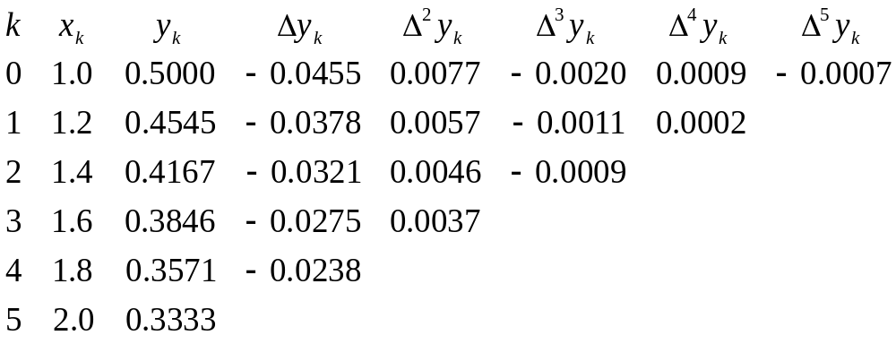
Solution
Forward-difference Table
prepared by Razana Alwee

Slide 11
Solution
x = 1.1 is between 1.0 and 1.2,(choose one value for the reference point- have highest forward-difference degree)
IChoose x₀ = 1.0 as reference value as have 5 forward different degree, Δ⁵y_{k})
Thus, h = 1.2 – 1.0 = 0.2 and
r = (x – x₀) / h = (1.1 – 1.0) / 0.2 = 0.5
prepared by Razana Alwee
Notes:
prepared by Razana Alwee

Slide 12
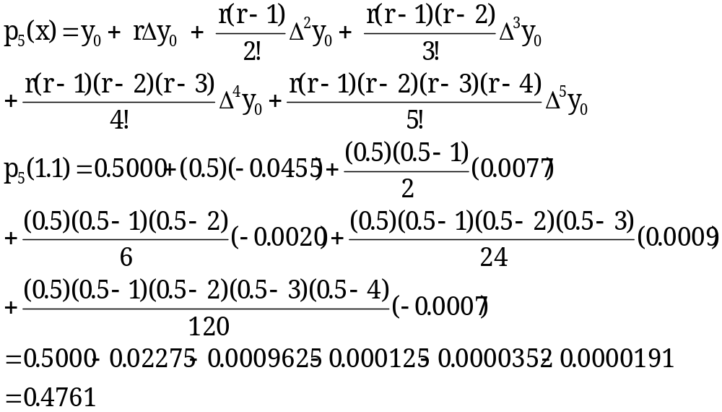
Solution
Polynomial
prepared by Razana Alwee
Notes:
prepared by Razana Alwee

Slide 13
Conclusion
The Newton Forward Difference formula suitable to determine the approximation of the data point lies near the beginning/centre of the table.
This will give more accuracy of the approximation value of the data point as it involved the highest-order difference.
prepared by Razana Alwee
Notes:
prepared by Razana Alwee

Slide 14
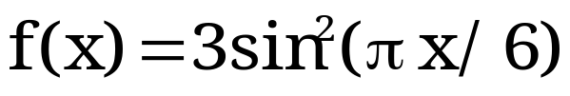
Exercise
Given
Use the Newton forward-difference formula to approximate f(1.5).
Compare the approximate f(x) with the actual value based on the following function, f(x)
X | 0.0 | 1.0 | 2.0 | 3.0 | 4.0
f(x) | 0.00 | 0.75 | 2.25 | 3.00 | 2.25
prepared by Razana Alwee
Notes:
prepared by Razana Alwee

Slide 15
Solution
Newton Forward-Difference table
k | x | f(x) | Δf(x) | Δ²f(x) | Δ³f(x) | Δ⁴f(x)
0 | 0.0 | 0.00 | 0.75 | 0.75 | -1.50 | 0.75
1 | 1.0 | 0.75 | 1.50 | -0.75 | -0.75
2 | 2.0 | 2.25 | 0.75 | -1.50
3 | 3.0 | 3.00 | -0.75
4 | 4.0 | 2.25
prepared by Razana Alwee
Notes:
prepared by Razana Alwee

Slide 16
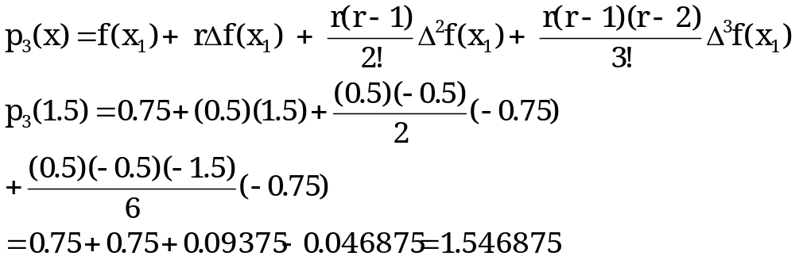
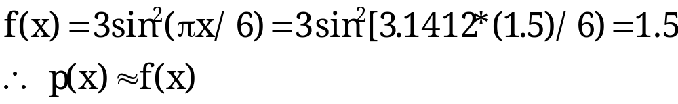
Solution
Polynomial
The difference with actual value
prepared by Razana Alwee
Notes:
prepared by Razana Alwee

Slide 17
Newton Backward- Difference Formula
Apply for the consistent data points..
For any x, x₀ ≤ x ≤ x_{n} can be written as:
In general:
x = x₀ + rh with 0 ≤ r ≤ n
x = x₁ + (r + n – 1)h
prepared by Razana Alwee
Notes:
prepared by Razana Alwee

Slide 18
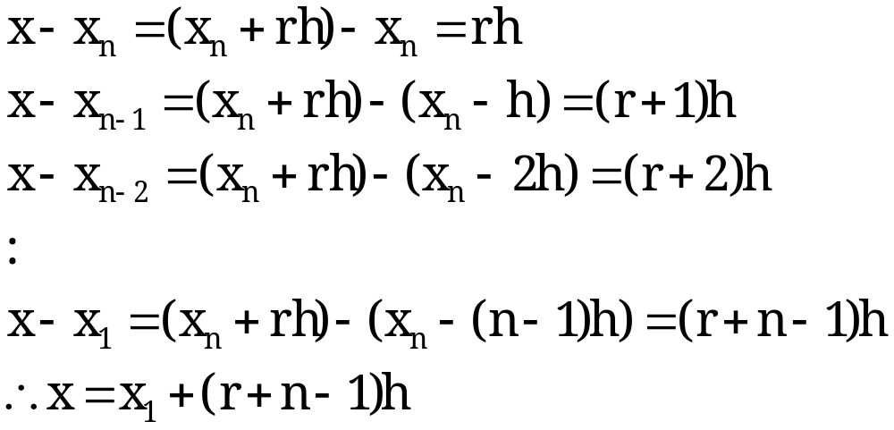
Newton Backward- Difference Formula
Proven:
prepared by Razana Alwee
Notes:
prepared by Razana Alwee

Slide 19

Newton Backward- Difference Formula
Backward Difference Notation
Stage | Notation | Definition
0 | ∇⁰y_{k} | y_{k}
1 | ∇¹y_{k} atau ∇y_{k} | y_{k} – y_{k-1}
2 | ∇²y_{k} | ∇y_{k} – ∇y_{k-1}
3 | ∇³y_{k} | ∇²y_{k} – ∇²y_{k-1}
… | … | …
j – 1 | ∇^{j-1}y_{k} | ∇ ^{j-2}y_{k} – ∇^{j-2}y_{k-1}
j | ∇^{j}y_{k} | ∇^{j-1}y_{k} – ∇^{j-1}y_{k-1}
prepared by Razana Alwee
Notes:
prepared by Razana Alwee

Slide 20
Newton Backward -Difference Formula
Backward Difference Table
k | x_{k} | y_{k} | ∇y_{k} | ∇²y_{k} | … | ∇^{n-1}y_{k} | ∇^{n}y_{k}
0 | x₀ | y₀
1 | x₁ | y₁ | ∇y₁
… | … | … | … | …
n – 2 | x_{n-2} | y_{n-2} | ∇y_{n-2} | ∇²y_{n-2} | …
n – 1 | x_{n-1} | y_{n-1} | ∇y_{n-1} | ∇²y_{n-1} | … | ∇^{n-1}y_{n-1}
n | x_{n} | y_{n} | ∇y_{n} | ∇²y_{n} | … | ∇^{n-1}y_{n} | ∇^{n}y_{n}
prepared by Razana Alwee
Notes:
prepared by Razana Alwee

Slide 21
Newton Backward -Difference Formula
Newton Backward-Difference Formula
r = (x – x_{k}) / h
prepared by Razana Alwee
Notes:
prepared by Razana Alwee

Slide 22
Example
Given the data in the table, Use the Newton backward-difference formula to approximate y(1.9).
k | 0 | 1 | 2 | 3 | 4 | 5
x_{k} | 1.0 | 1.2 | 1.4 | 1.6 | 1.8 | 2.0
y_{k} | 0.5000 | 0.4545 | 0.4167 | 0.3846 | 0.3571 | 0.3333
prepared by Razana Alwee
Notes:
prepared by Razana Alwee

Slide 23
Solution
Newton Backward Difference table
k | x_{k} | y_{k} | ∇y_{k} | ∇²y_{k} | ∇³y_{k} | ∇⁴y_{k} | ∇⁵y_{k}
0 | 1.0 | 0.5000
1 | 1.2 | 0.4545 | -0.0455
2 | 1.4 | 0.4167 | -0.0378 | 0.0077
3 | 1.6 | 0.3846 | -0.0321 | 0.0057 | -0.0020
4 | 1.8 | 0.3571 | -0.0275 | 0.0046 | -0.0011 | 0.0009
5 | 2.0 | 0.3333 | -0.0238 | 0.0037 | -0.0009 | 0.0002 | -0.0007
prepared by Razana Alwee
Notes:
prepared by Razana Alwee

Slide 24
Solution
x = 1.9 lies between 1.8 dan 2.0,
Choose x₅ = 2.0 as reference point since have highest order of backward-reference , ∇⁵y_{k})
Thus, h = 1.2 – 1.0 = 0.2 and
r = (x – x₅) / h = (1.9 – 2.0) / 0.2 = -0.5
prepared by Razana Alwee
Notes:
prepared by Razana Alwee

Slide 25
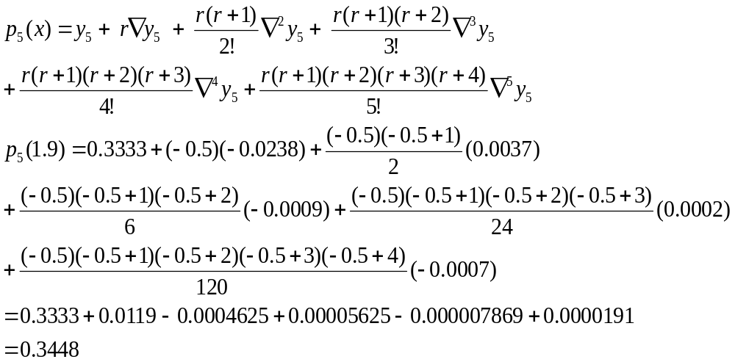
Solution
Polynomial
prepared by Razana Alwee
Notes:
prepared by Razana Alwee

Slide 26
Conclusion
The Newton Backward Difference formula suitable to determine the approximation of the data point lies near the end of the table.
prepared by Razana Alwee
Notes:
prepared by Razana Alwee

Slide 27
Example
Based on the given data in the table, Use the Newton backward-difference formula to approximate f(3.5).
Compare the approximate f(x) with the actual value based on the following function, f(x)
x | 0.0 | 1.0 | 2.0 | 3.0 | 4.0
f(x) | 0.00 | 0.75 | 2.25 | 3.00 | 2.25
prepared by Razana Alwee
Notes:
prepared by Razana Alwee

Slide 28
Solution
Newton Backward-Difference table
Thus, h = 1.0 – 0.0 = 1.0 and
r = (x – x₄) / h = (3.5 – 4.0) / 1.0 = -0.5
k | x | f(x) | ∇f(x) | ∇²f(x) | ∇³f(x) | ∇⁴f(x)
0 | 0.0 | 0.00
1 | 1.0 | 0.75 | 0.75
2 | 2.0 | 2.25 | 1.50 | 0.75
3 | 3.0 | 3.00 | 0.75 | -0.75 | -1.50
4 | 4.0 | 2.25 | -0.75 | -1.50 | -0.75 | 0.75
prepared by Razana Alwee
Notes:
prepared by Razana Alwee

Slide 29
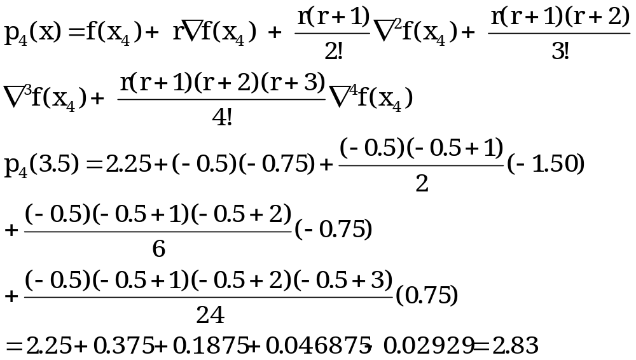
Solution
Polynomial
prepared by Razana Alwee
Notes:
prepared by Razana Alwee

Slide 30
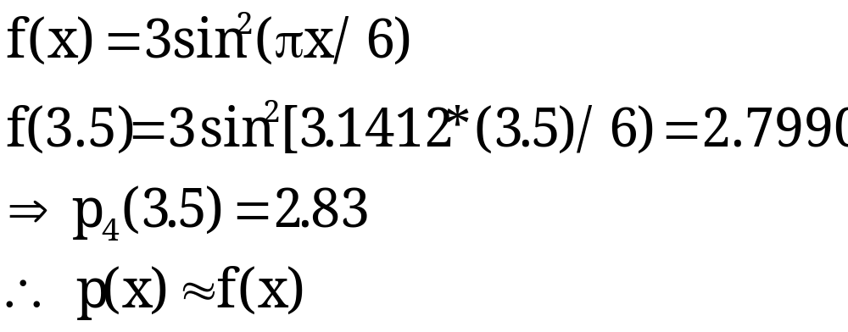
Solution
Comparison with the actual value
prepared by Razana Alwee
Notes:
prepared by Razana Alwee

Slide 31
Exercise
Given
(0.0 , 0.0), (0.2 , 1.05), (0.4 , 0.85), (0.6 , 0.35),
(0.8 , 0.10), (1.0 , 1.0).
Use an appropriate interpolation technique to determine the approximation value of :
y(0.1)
y(0.9)
prepared by Razana Alwee
Notes:
prepared by Razana Alwee

Slide 32
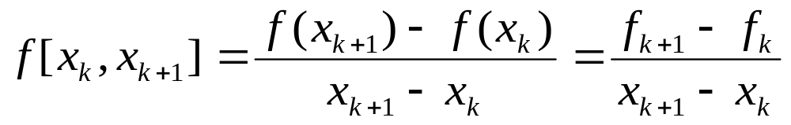
Newton’s Divided-Difference
Suitable for non uniform data
The zeroth divided difference of the function f with respect to x_{k}
f[x_{k}] = f(x_{k})
First divided difference of f with respect to x_{k} and x_{k+1}

Slide 33
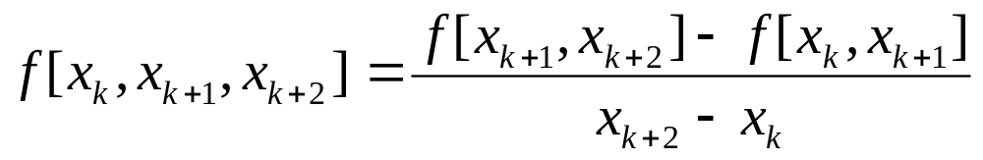
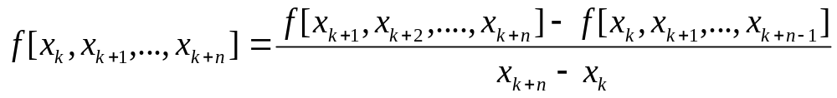
Newton’s Divided-Difference
  Second divided difference f with respect to x_{k} , x_{k+1} and x_{k+2}
  kth divided difference f with respect to x_{k} , x_{k+1 ,} x_{k+2…….}x_{k+n}

Slide 34






Newton Divided-Difference table
k | x_{k} | f[x_{k}] | f[x_{k}, x_{k+1}] | f[x_{k}, x_{k+1}, x_{k+2}] | … | f[x_{k}, x_{k+1},…, x_{k+n}]
0 | x₀ | f₀ |  |  | …
1 | x₁ | f₁ |  |  | …
… | … | … | … | …
n – 1 | x_{n-1} | f_{n-1}
n | x_{n} | f_{n}

Slide 35
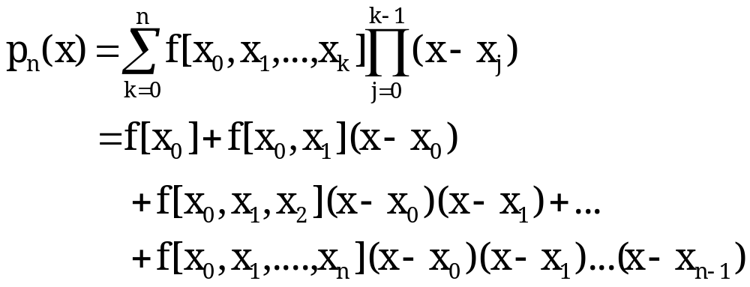
Newton’s Divided-Difference
The Newton divided-difference interpolating polynomial determine based on the first point with the highest number of divided difference:

Slide 36
Example 1
Construct the Newton divided-difference table based on the following data
Determine the approximation value of y(1.3)
k | 0 | 1 | 2 | 3 | 4
x_{k} | 1.0 | 1.6 | 2.5 | 3.0 | 3.2
y_{k} | 0.5000 | 0.3846 | 0.2857 | 0.2500 | 0.2381

Slide 37
Solution
Newton divided-difference table
k | x_{k} | f[x_{k}] | f¹[x_{k}] | f²[x_{k}] | f³[x_{k}] | f⁴[x_{k}]
0 | 1.0 | 0.5000 | -0.1923 | 0.0549 | -0.0137 | 0.0032
1 | 1.6 | 0.3846 | -0.1099 | 0.0275 | -0.0066
2 | 2.5 | 0.2857 | -0.0714 | 0.0170
3 | 3.0 | 0.2500 | -0.0595
4 | 3.2 | 0.2381

Slide 38
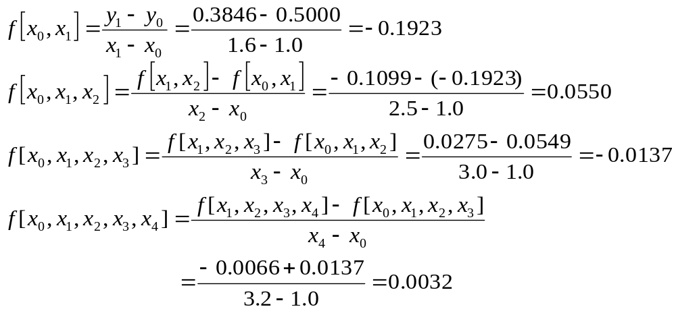
Solution
Solution
Calculation

Slide 39
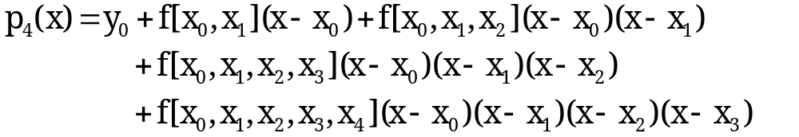
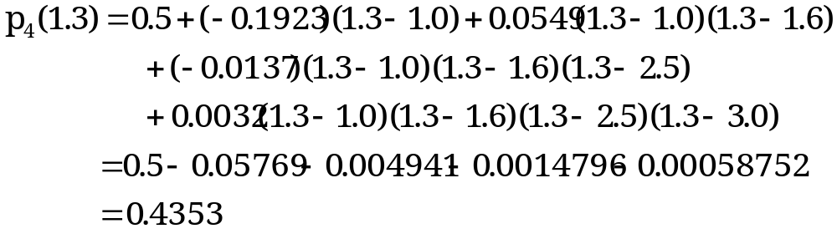
Solution
Solution
Interpolation Polynomial expression
Assign the value into the polynomial expression

Slide 40
Conclusion
Can be used to determine the approximation of the point lies near the beginning of the table where x₀ < x < x₁.
The data need to be reordered, if the point is not located at the beginning of the table
  Determine the range of data where the point is located and label the lower bound range as, x₀ and the upper bound as x₁
  Ordered the data starting with the value that closest with the point as x₂ followed by the other values as x₃,x₄….x_{n} where x_{n} have the largest gap with the point.

Slide 41
Example 2
Construct the Newton divided-difference table based on the following data:
Determine the approximation value of y(2.8)
k | 0 | 1 | 2 | 3 | 4
x_{k} | 1.0 | 1.6 | 2.5 | 3.0 | 3.2
y_{k} | 0.5000 | 0.3846 | 0.2857 | 0.2500 | 0.2381

Slide 42

Solution
Position of X= 2.8
Assign x₀ = 2.5 and x₁ = 3.0
X₂ = ? X₃=? X₄=?
k | 0 | 1 | 2 | 3 | 4
x_{k} | 1.0 | 1.6 | 2.5 | 3.0 | 3.2
y_{k} | 0.5000 | 0.3846 | 0.2857 | 0.2500 | 0.2381
The point lies between 2.5 and 3.0

Slide 43
Solution
Newton Divided-Difference value
k | x_{k} | f[x_{k}] | f¹[x_{k}] | f²[x_{k}] | f³[x_{k}] | f⁴[x_{k}]
0 | 2.5 | 0.2857 | -0.0714 | 0.0170 | -0.0066 | 0.0033
1 | 3.0 | 0.2500 | -0.0595 | 0.0229 | -0.0115
2 | 3.2 | 0.2381 | -0.0916 | 0.0458
3 | 1.6 | 0.3846 | -0.1923
4 | 1.0 | 0.5000

Slide 44
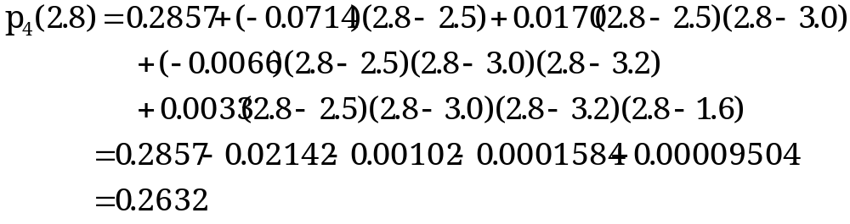
Solution
Solution
Polynomial expression
Assign the value into the expression

Slide 45
Exercise
Construct the Newton divided-difference table based on the following data:
Determine the approximation value of f(2.2) and f(7.0).
k | 0 | 1 | 2 | 3 | 4
x_{k} | 2.0 | 3.0 | 6.5 | 8.0 | 12.0
f(x_{k}) | 14.0 | 20.0 | 17.0 | 16.0 | 23.0

Slide 46
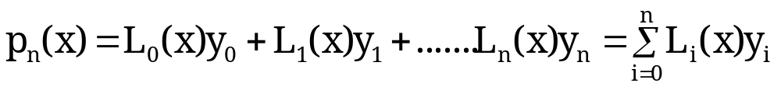
Lagrange Interpolating Polynomials
Denoted as L_{k}(x).
Suitable do the approximation value of point for non uniform data.
Interpolation is relied on the number of data that been given

Slide 47
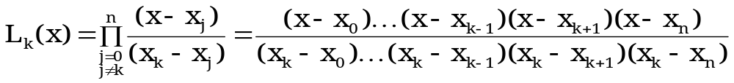
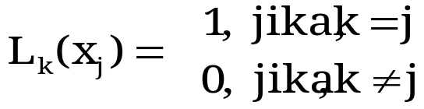
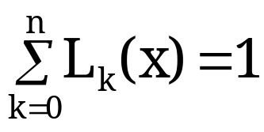
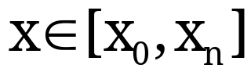
Lagrange Interpolating Polynomials
Where
Subject to
It shows that ⇨
  It is true for any
  And can be used to check the calculation

Slide 48
Example
Given
Determine the approximation value of y(1.3).
k | 0 | 1 | 2 | 3 | 4
x_{k} | 1.0 | 1.6 | 2.5 | 3.0 | 3.2
y_{k} | 0.5000 | 0.3846 | 0.2857 | 0.2500 | 0.2381

Slide 49
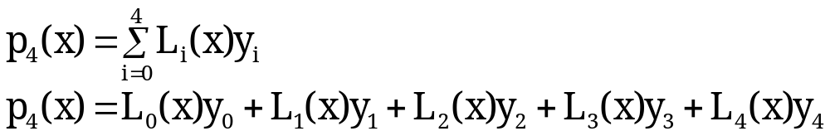
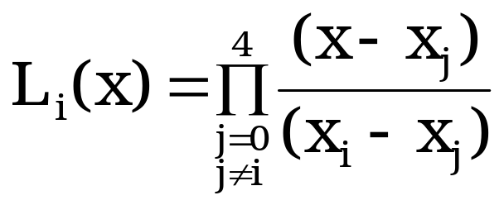
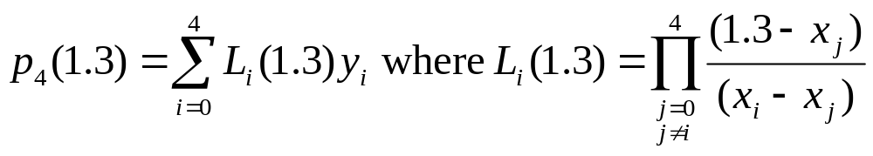
Solution
Based on the data given
where
Therefore,

Slide 50
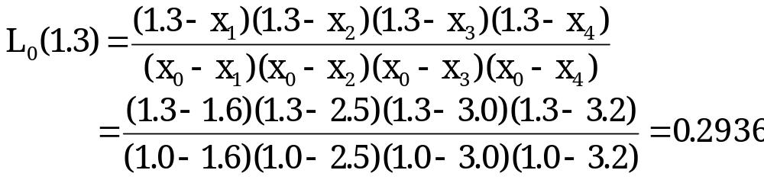
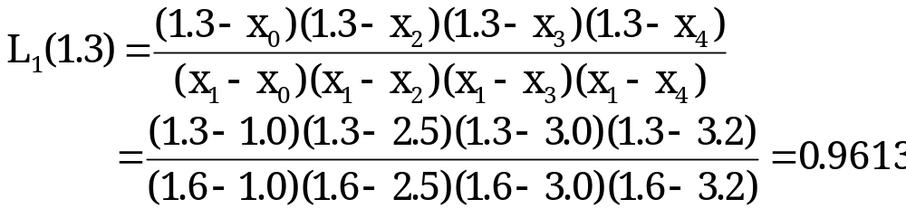
Solution
Calculate L₀(1.3)
Calculate L₁(1.3)

Slide 51
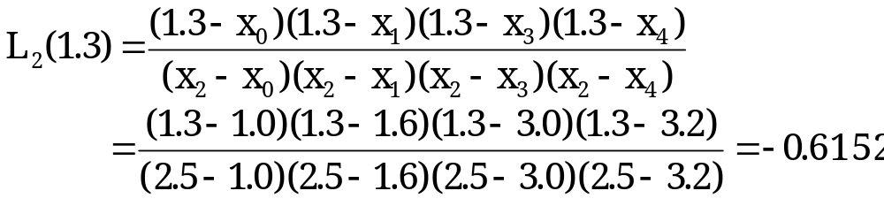
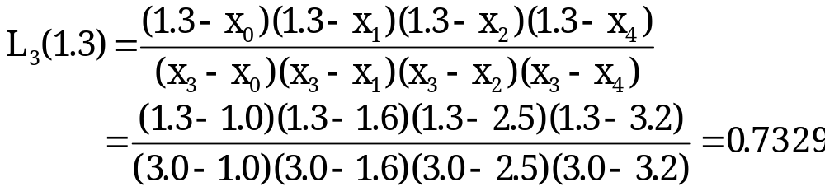
Solution
Calculate L₂(1.3)
Calculate L₃(1.3)

Slide 52
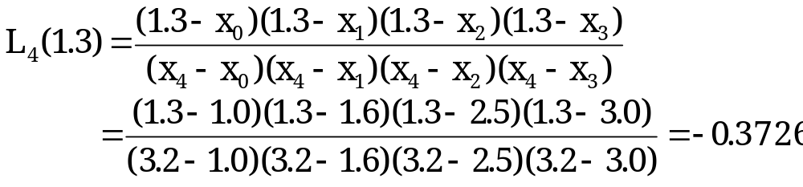
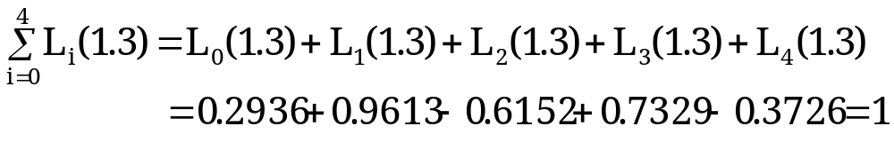
Solution
Calculate L₄(1.3)
Check:

Slide 53
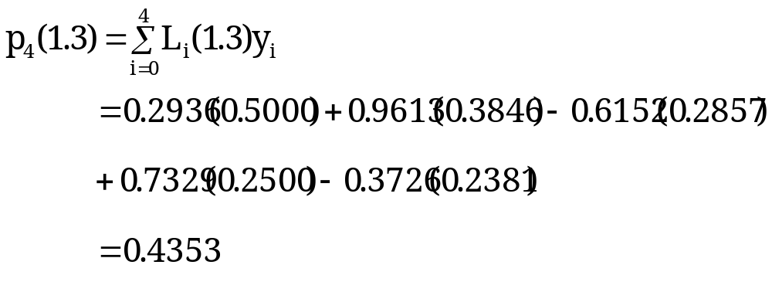
Solution
Thus,

Slide 54
Exercise 2
Given
Determine the approximation value of f(2.2) and f(7.0) based on Lagrance interpolating polynomials method
k | 0 | 1 | 2 | 3 | 4
x_{k} | 2.0 | 3.0 | 6.5 | 8.0 | 12.0
f(x_{k}) | 14.0 | 20.0 | 17.0 | 16.0 | 23.0

Slide 55
Solution
Location of x = 2.2:
k | 0 | 1 | 2 | 3 | 4
x_{k} | 2.0 | 3.0 | 6.5 | 8.0 | 12.0
f(x_{k}) | 14.0 | 20.0 | 17.0 | 16.0 | 23.0
Lies between 2.0 dan 3.0

Slide 56
Solution
Table
k | x_{k} | f[x_{k}] | f¹[x_{k}] | f²[x_{k}] | f³[x_{k}] | f⁴[x_{k}]
0 | 2.0 | 14.0 | 6.0000 | -1.5238 | 0.2603 | -0.0216
1 | 3.0 | 20.0 | -0.8571 | 0.0381 | 0.0446
2 | 6.5 | 17.0 | -0.6667 | 0.4394
3 | 8.0 | 16.0 | 1.7500
4 | 12.0 | 23.0

Slide 57
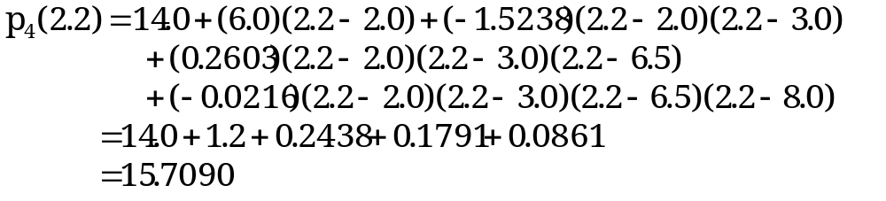
Solution
Polynomial expression
Assign the value

Slide 58
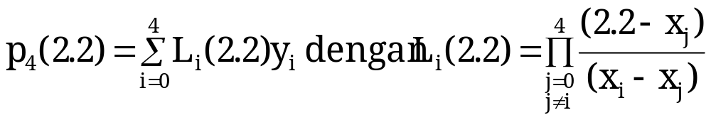
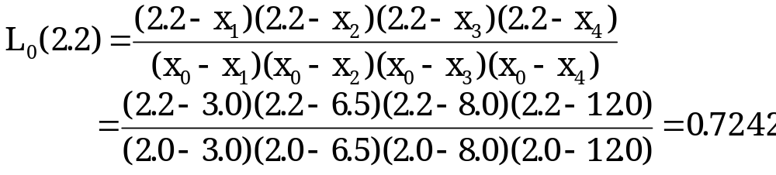
Solution exercise 2
Thus,
Calculate:

Slide 59
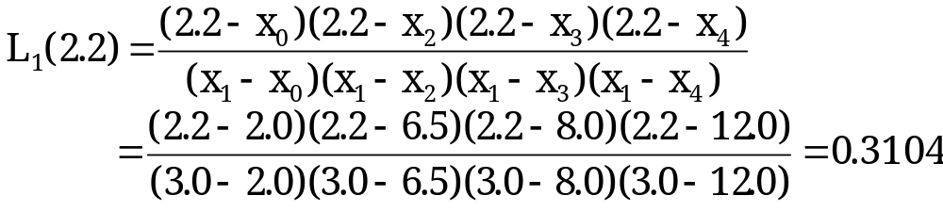
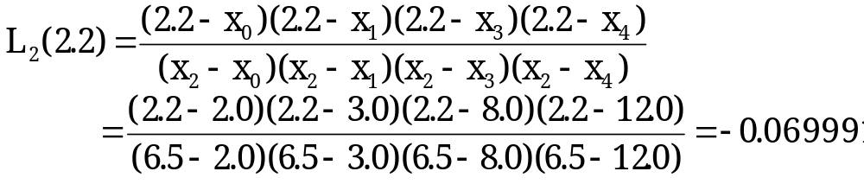
Solution
Calculate
Calculate

Slide 60
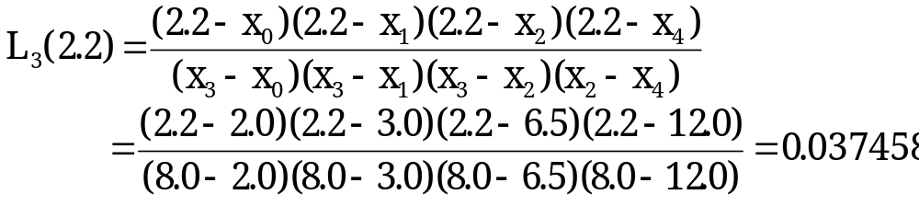
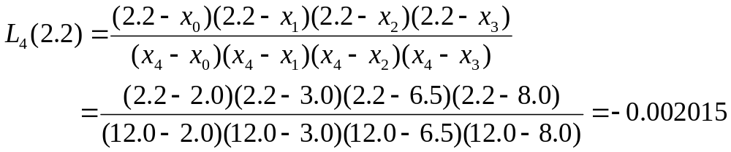
Solution
Calculate
Calculate

Slide 61
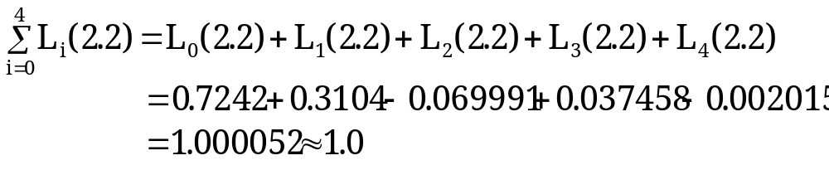

Solution
Check
Thus:

Slide 62

Least Square approximation
Determine the coefficient values of polynomials,( a₀, a₁, …, a_{m} ) to minimise the sum or error square difference between p(x_{k}) dan f_{k} at any points based on
where
ε_{k} is the error at point x_{k} which is the difference between the approximation value based on the polynomial , p(x_{k}) and the actual value at point x_{k}
S ia the summation of error square at all points k=0,1,…n.

Slide 63


Least Square approximation
Thus, we required that
be minimum
The minimum value of S can be obtained when the partial differential is equal 0 for j = 0, 1, …, m

Slide 64


Least Square approximation
It gives
In Linear system equation form :

Slide 65


Penghampiran Kuasa Dua Terkecil
where
Matrix form

Slide 66
Least Square approximation
The coefficient values of a₀, a₁, …, a_{m} can be determine using the system of linear equations method that been discussed in chapter 2.

Slide 67
Example
Determine the appropriate linear polynomial expression, p(x) = a₀ + a₁x based on the following data:
Determine f(4.5)
k | 0 | 1 | 2 | 3 | 4
x_{k} | 1 | 3 | 4 | 5 | 8
f_{k} | 5 | 9 | 11 | 13 | 19

Slide 68



Solution
System of linear equations
where
and

Slide 69

Solution
Calculation table:
 | x_{k}⁰ | X_{k}¹ | x_{k}² | f_{k} | x_{k}⁰f_{k} | x_{k}¹f_{k}
 | 1 | 1 | 1 | 5 | 5 | 5
 | 1 | 3 | 9 | 9 | 9 | 27
 | 1 | 4 | 16 | 11 | 11 | 44
 | 1 | 5 | 25 | 13 | 13 | 65
 | 1 | 8 | 64 | 19 | 19 | 152
 | 5 | 21 | 115 | - | 57 | 293

Slide 70


Solution
In matrix form :
Solution, a₀ = 3.0 dan a₁ = 2.0
Therefore, the polynomial expression is p(x) = 2.0x + 3.0
To determine f(4.5):

Slide 71
Exercise
Determine the appropriate linear polynomial expression, p(x) = a₀ + a₁x based on the following data:
Determine f(2.3)
x | 1 | 2 | 3 | 4 | 5
f(x) | 0.50 | 1.40 | 2.00 | 2.50 | 3.10

Slide 72
solution
In matrix form :
with
and

Slide 73
solution
Calculation table:
 | x_{k}⁰ | x_{k}¹ | x_{k}² | f_{k} | x_{k}⁰f_{k} | x_{k}¹f_{k}
 | 1 | 1 | 1 | 0.5 | 0.5 | 0.5
 | 1 | 2 | 4 | 1.4 | 1.4 | 2.8
 | 1 | 3 | 9 | 2.0 | 2.0 | 6.0
 | 1 | 4 | 16 | 2.5 | 2.5 | 10.0
 | 1 | 5 | 25 | 3.1 | 3.1 | 15.5
 | 5 | 15 | 55 | - | 9.5 | 34.8

Slide 74


solution
In matrix form : sa = v
Solution, a₀ = 0.01 dan a₁ = 0.63
Therefore, the polynomial expression is p(x) = 0.01x + 0.63
To determine f(2.3):

